Slide 1
Diversity Inside Out - Module 4:
Post Covid Changes and Challenges for a Diverse Workforce
"The European Commission support for the production of this publication does not constitute an endorsement of the contents which reflects the views only of the authors, and the Commission cannot be held responsible for any use which may be made of the information contained therein."
Notes:
See these notes on employment rights in NL (Conversation Club Facilitators’ Guide)

Slide 2
Welcome!
Find the settings option to test your microphone if you have one.
To participate via text chat during the session find the icon on your screen to the right left select 'Everyone’.
NB. If you lose audio in the session, please let me know!
During the session, please mute your microphone unless you wish to speak.
If you lose connection, you can re-join this meeting by following the original link we sent you in your email.
Thanks. Say hi in the chat box.
Grab a paper and pen to make notes.
We will send you some resources and further information after today’s session

Slide 3
Please drop in chat:
Your name?
How do you feel today?

Slide 4
Inova Aspire
We provide high quality training and educational programmes to empower individuals and organisations.
Our commitment is to embrace diversity in the field of gender, disability, race, age and religion in order to support personal and professional development.
Themes for our training: wellbeing and happiness, mindful approaches, innovation in mindful ageing, equality approaches, youth development to address worklessness, women’s leadership development.

Slide 5
Diversity Inside Out Project – Recap previous session
What did you enjoy about the last session?
What did you learn?
Have you implemented any of the learning within your workplace?

Slide 6
We will cover:
The changing world of work
Changing employee expectations
The great resignation
Attracting candidates and the flexibility advantage for employees
Avoiding fake flex
Case study discussions
Action planning

Slide 7
Post Covid Changes and Challenges for a Diverse Workforce
What have been your workplace challenges during Covid?
Post Covid: What changes and challenges are there now in your workplace?
Notes:
Menti meter?

Slide 8
Which people have been most affected by Covid-19- workplace effects?
Young people-25% of employers were not planning to hire young people in 2021.
19% of young people furloughed during the first lockdown were unemployed by September 2020.
Two-thirds of laid off workers were under 25.
Women-35% of working mothers have lost work or seen hours cut because of childcare responsibilities.
Older workers- some have delayed retirement because of the pandemic and rising prices.
Changes to Covid related sick pay-all workers affected- more likely to work if unwell.
Photo by Anna Dziubinska on Unsplash
Notes:
Stats in italics from CIPD People Management magazine Feb 2021
Check still relevant may need updating by delivery date/ incorporate recession?

Slide 9
Which people have been most affected by Covid-19- workplace effects?
At risk groups- stress, risks to employability:
Certain organisational staff on front line- health care, nursing, care home staff, paramedics, police, emergency services, teachers-exposure to trauma, prolonged stress
Effects of exclusion- race, age
Work roles disappearing- retail, sales, hospitality-workplace will be structured differently- new roles, growth areas, some roles disappearing
Photo by Anna Dziubinska on Unsplash

Slide 10
Intersectionality- multiple disadvantage
Disability
Gender
Age
Class
Religion
LGBTQi+
Language
Skill
level
Social exclusion
Migrant
Notes:
Move arrows
This is constantly evolving as society changes. Post pandemic we will have many people suffering with mental health issues which will become much more recognised as disadvantage- anxiety, not able to make appointments, affects ability to do job even if you want to work
Discuss: We could add mental health to this too
Class –still a class-based society
LGBTQI info
https://www.standard.co.uk/lifestyle/what-does-lgbtqia-stand-for-a4460116.html

Slide 11
Young people and black graduates most likely to be unemployed because of Covid (2021)
A report from the Resolution Foundation found that between the second and third quarters of 2020 the unemployment rate among 18 to 24-year-olds jumped from 11.5 per cent to 13.6 per cent – an 18 per cent increase for this age group and the highest quarterly rise since 1992.
The rise was even greater among black graduates, who saw unemployment increase to 34 per cent, up from 22 per cent before the pandemic.
In comparison, the unemployment rate was 25 per cent among Asian graduates and just 12 per cent among white graduates.
Report findings (14 Apr 2021) Brown.J
Notes:
https://www.peoplemanagement.co.uk/news/articles/young-people-and-black-graduates-most-likely-to-be-unemployed-because-of-covid#gref

Slide 12
Young people face threat of unemployment in the future
Unemployment affects long-term earning and learning prospects
Youth unemployment will cost the UK nearly £7bn next year, according to a new report, which warns that it will remain high despite the economy starting to recover from the pandemic.
Analysis from the Learning and Work Institute and The Prince’s Trust has forecast that the economic cost of youth unemployment in terms of lost national output would increase to £6.9bn in 2022.
New graduates struggling to get first jobs.
Notes:
https://www.peoplemanagement.co.uk/news/articles/young-people-and-black-graduates-most-likely-to-be-unemployed-because-of-covid#gref
https://www.resolutionfoundation.org/publications/uneven-steps/

Slide 13
Power shifts- changing world of work
The changing world of work
Higher employee expectations?
Work as development of the self.

Slide 14
What do employees want from work?
Work needs to provide hedonic and eudaimonic purpose- provide both pleasure and meaning
Drive for meaning and control
Wellbeing valued
Work/life balance
Personal development opportunities-has always been the case but investment in careers expected
Photo by israel palacio on Unsplash

Slide 15
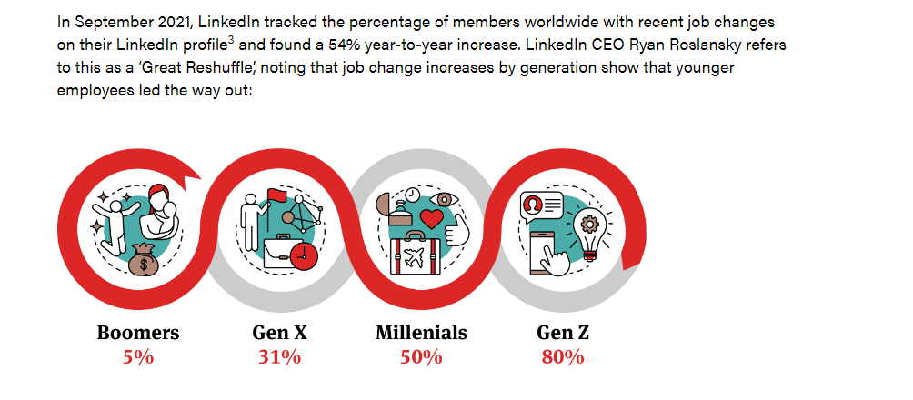
Post Covid effects- the great resignation-Dr Anthony Klotz
Worldwide phenomenon- epiphanies about family time, remote work, commuting, passion projects, contemplation about life-death
Not a pause but a reset. Views of work have changed forever.
https://www.nortonrosefulbright.com/en-nl/knowledge/publications/cc03a277/the-great-resignation-a-global-risk#:~:text=The%20term%20'Great%20Resignation'%20was,the%20end%20of%20the%20pandemic.
Notes:
Source:
https://www.nortonrosefulbright.com/en-nl/knowledge/publications/cc03a277/the-great-resignation-a-global-risk#:~:text=The%20term%20'Great%20Resignation'%20was,the%20end%20of%20the%20pandemic.

Slide 16
Loss of older workers
The great resignation

Slide 17
Post Covid effects- the great resignation
Reshuffling. Employees are quitting and going to different employers in different industries . Some industries are disproportionately losing talent, others are struggling to attract talent, and some are grappling with both.
Reinventing. Many employees leaving traditional employment are either going to nontraditional work (temporary, gig, or part-time roles) or starting their own businesses. Of the employees who quit without a new job in hand, 47 percent chose to return to the workforce. However, only 29 percent returned to traditional full-time employment.
Reassessing. Many people are quitting not for other jobs but because of the demands of life—they need to care for children, elders, or themselves. These are people who may have stepped out of the workforce entirely, dramatically shrinking the readily available talent pool.
What effects are you feeling?
Source:https://www.mckinsey.com/business-functions/people-and-organizational-performance/our-insights/the-great-attrition-is-making-hiring-harder-are-you-searching-the-right-talent-pools
Notes:
Menti meter?

Slide 18
Those who flex first may attract staff
Attracting candidates and the flexibility advantage

Slide 19
By 2025 Gen z workers will make up 27% of the workforce.
Born 1946-1964
Born 1965 and 1979/80
Born 1981-1997
Born 1997-2012/2015
Notes:
Source:
https://www.nortonrosefulbright.com/en-nl/knowledge/publications/cc03a277/the-great-resignation-a-global-risk#:~:text=The%20term%20'Great%20Resignation'%20was,the%20end%20of%20the%20pandemic.

Slide 20
Organisations have a segmented employment market according to generations-different expectations
Not interested in 40 hour week- want work/ life balance
Values- based work with a social and ethical purpose
Use voices and demand change
Remote working preference, international working from remote locations
Flexible work Flexible work-scheduling schedulat
Want to work in diverse organisations
Willing to evaluate companies on a set of moral standards
Want flexible benefits-perks e.g gym benefits, month’s paid time off
Support brands and employers aligned to values
Photo by Shingi Rice on Unsplash
Notes:
This group want flexible benefits, help with paying off debt, financial advice,
https://www.forbes.com/sites/ashleystahl/2021/05/04/how-gen-z-is-bringing-a-fresh-perspective-to-the-world-of-work/?sh=3fd8e27610c2
https://www.forbes.com/sites/forbeshumanresourcescouncil/2021/11/10/how-to-meet-gen-zs-workplace-expectations/?sh=56285d6a74ff

Slide 21
But how many organisations are targeting different groups of jobseekers?
Photo by Jason Goodman on Unsplash
Your situation?
Notes:
Menti meter?

Slide 22
Remote first…preference for home-based but hubs/ office for occasional scheduled collaboration
productivity
Your situation?
distributed leadership
reduced costs
Remote first
Enhanced accessibility
Improve employee satisfaction
Hire best talent
Notes:
Menti meter?

Slide 23
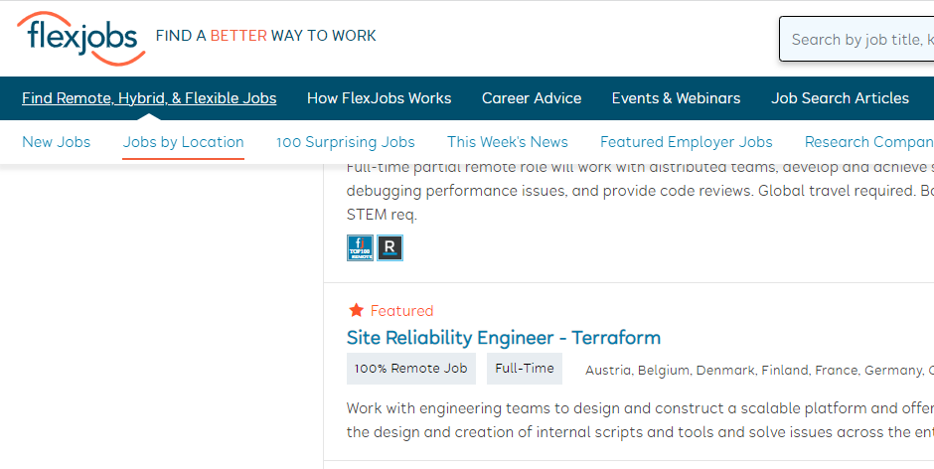
Many job sites are springing up to promote these remote jobs-can you compete?
Your situation?
Notes:
https://www.workingnomads.com/jobs
https://www.flexjobs.com/remote-jobs/world/United-Kingdom?category%5B%5D=166&location=United+Kingdom&location_page=true&nous=1&noworld=1&search=
https://www.remoteworker.co.uk/

Slide 24
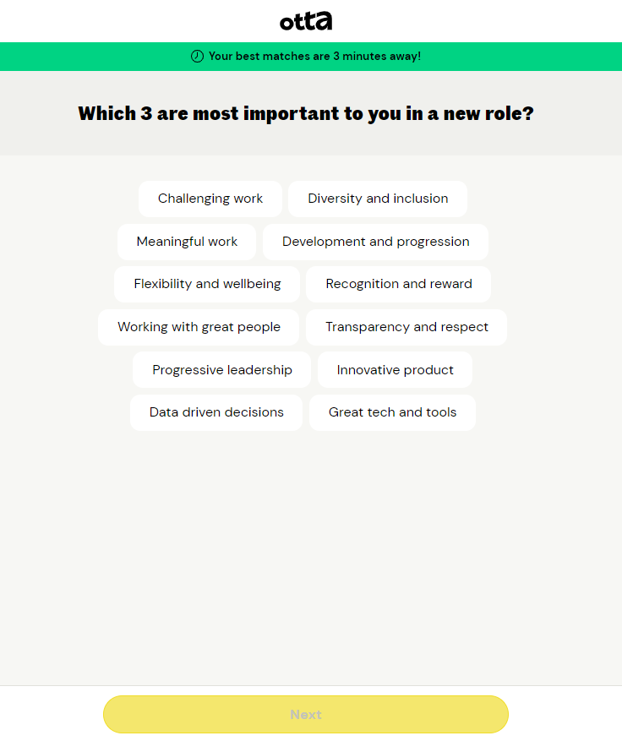
Example job site-Otta
Your situation?
Notes:
https://www.workingnomads.com/jobs
https://www.flexjobs.com/remote-jobs/world/United-Kingdom?category%5B%5D=166&location=United+Kingdom&location_page=true&nous=1&noworld=1&search=
https://www.remoteworker.co.uk/

Slide 25
Boom or recession shifts power
July 2022: 4/5 employers would recruit for potential as skills shortages continue to bite (CIPD).
What sense of the external environment are you making in your sector?
How does this influence the talent pool and your recruitment strategies?
Boom
Some sectors fare well, others can’t find staff
Wage inflation drift in some sectors
???
Inflation/ recession
Unemployment rate
Skills shortages
Wage inflation
Some retirees return to work to pay for services (higher gas and electricity prices)
???
Notes:
https://www.workingnomads.com/jobs
https://www.flexjobs.com/remote-jobs/world/United-Kingdom?category%5B%5D=166&location=United+Kingdom&location_page=true&nous=1&noworld=1&search=
https://www.remoteworker.co.uk/

Slide 26
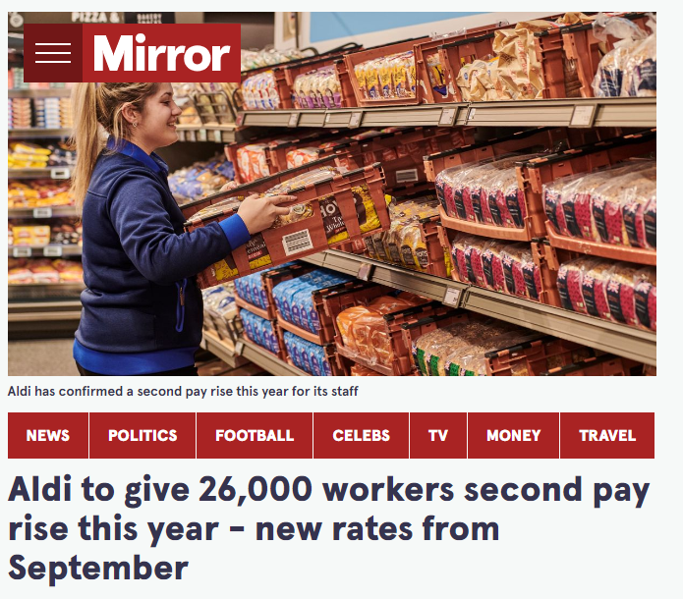
Inflation and soaring living costs
Initiatives to give competitive advantage.
One-off bonus/ top ups
Pay rises
Flexible benefits packages
Training and development loans/allowances
Your situation?
https://www.mirror.co.uk/money/aldi-give-26000-workers-second-27567028
Notes:
https://www.cipd.co.uk/knowledge/culture/well-being/cost-living-crisis
https://www.mirror.co.uk/money/aldi-give-26000-workers-second-27567028

Slide 27
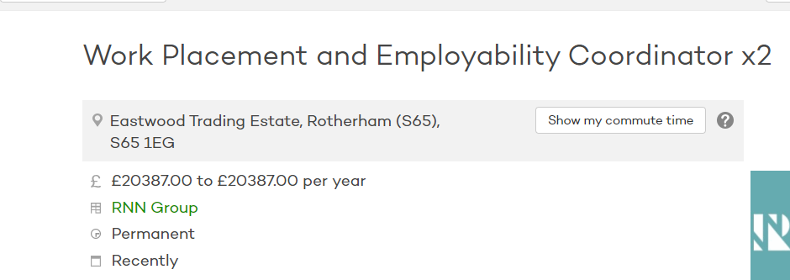
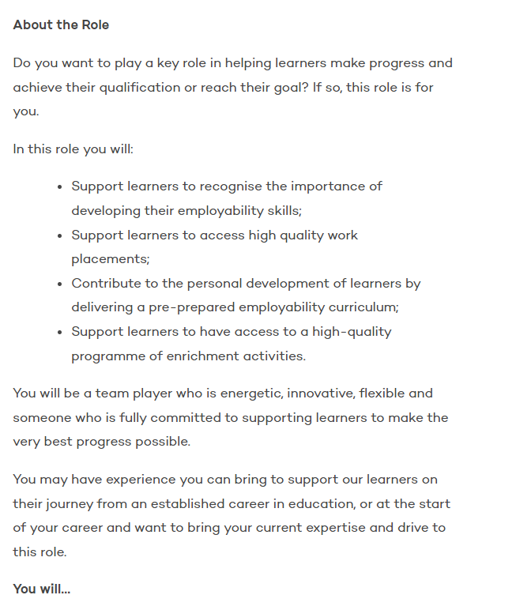
AIDA-attention, interest, desire, action…
What’s in it for me?
Notes:
https://www.cipd.co.uk/knowledge/culture/well-being/cost-living-crisis
https://www.mirror.co.uk/money/aldi-give-26000-workers-second-27567028

Slide 28
BREAK
Notes:
15 minutes

Slide 29
Badger and Bodgett (manufacturing SME)
Managed through Covid 19
18 employees
Furloughed some, now all back at work
Management, administrative, sales and HR staff worked from home, many continue to want home working, but likely to be hybrid teams- part home working, part at the site.
Mid- Covid anonymous employee pulse survey was taken.

Slide 30
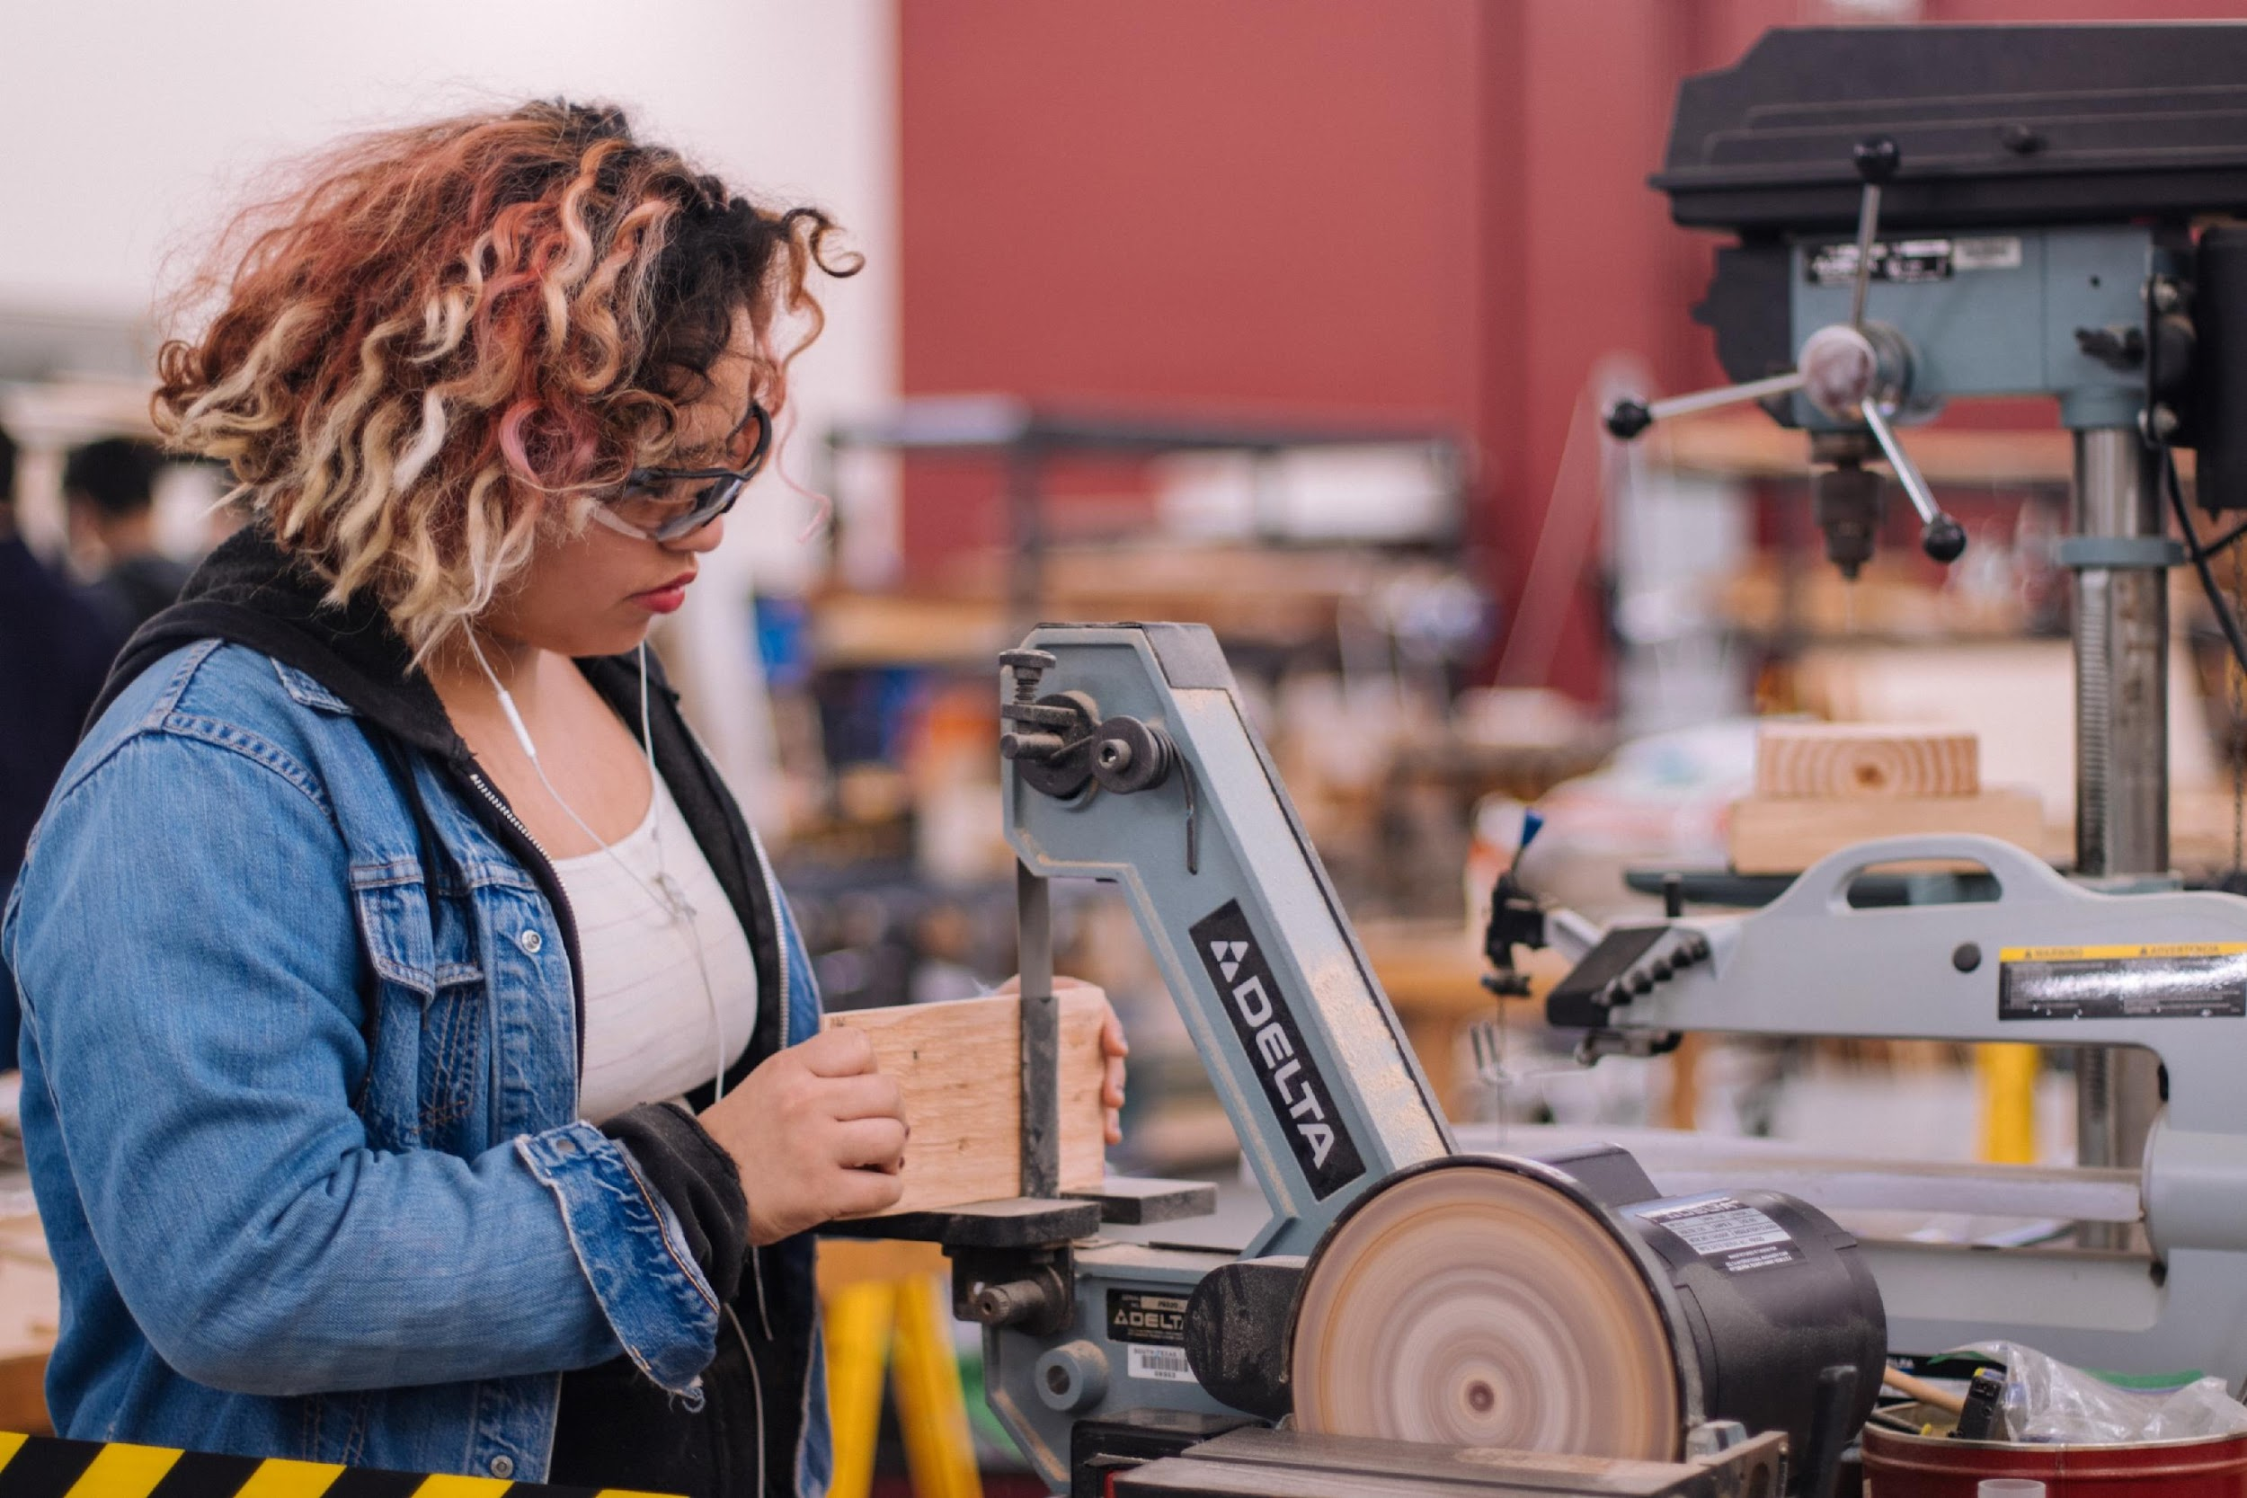
Employee survey findings.
‘Policies not administered fairly-it depends if your face fits.’
‘There seem to be favourites who get the best jobs.’
‘As a woman, I wonder if I’ll ever get promoted here.’
‘I am surprised there is so much banter and lack of professionalism. I’d like to let my colleagues know I’m gay, but it could be career-limiting.’
‘Us and them culture- you can job share if you work in office but not on shop floor-why not?.’
Photo by Jeswin Thomas on Unsplash

Slide 31
Employee survey findings.
67% actively looking for new jobs.
54% said management practices greatest source of stress- lack of access to training, inconsistent policies, poor workload management, uncertainty about the future.
12% satisfied with pay, term and conditions.
32% said they had not developed any skills in past two years.
42% wanted more flexible working opportunities but had been declined it because of business needs.
76% reported low morale and engagement.

Slide 32
Badger and Bodgett (manufacturing SME)
Post Covid Actions
What can be done to make businesses more sustainable?
What can be done to make organisations more inclusive?
What ideas do you have?
Make a few notes before going in to your group for further discussion on this topic.
Identify at least three action points
Notes:
Retention and talent development, promotion
Training and development
Equality and flexible working
Processes and systems

Slide 33
What do we mean by flexibility ?
Jenna HR Manager
We have flexible working: part time, job share and term time contracts.
We have a carer’s register.
Our workforce is quite representative of our local population.
Is this enough?
Photo by Christina @ wocintechchat.com on Unsplash
Notes:
Use case studies or the diversity cards for learners to discuss in their groups to see where flexibility could be applied to specific jobs or individuals.

Slide 34
What do we mean by flexibility ?
Case studies/Diversity Cards
Other topics promotion data set to look at
Flexibility caring responsibilities, children
Disability reasonable adjustments
Notes:
Use case studies or the diversity cards for learners to discuss in their groups to see where flexibility could be applied to specific jobs or individuals.

Slide 35
Benefits of in-organisation lived experience research
Can offer renewed energy to drive change
Collects new data for a richer picture to understand issues
Could reveal hidden issues senior management not even aware of
Enables more nuanced responses
Full context needs to be communicated-provide psychological safety
Avoid ‘project’ mentality
Data collection: Needs to be analysed, followed by action (timely)
Start to take action and implement plans for change quite quickly

Slide 36
Case Studies or Diversity Cards
Halima
Nari
David

Slide 37
What is fake flex?
“Fake-flex”, a term coined by Flex Appeal campaigners Anna Whitehouse and Matt Farquharson, is used to define home working without proper policies in places that require employees to be constantly online or available for their business.
https://techmonitor.ai/leadership/workforce/fake-flex-working-homeworking-covid-19#:~:text=%E2%80%9CFake%2Dflex%E2%80%9D%2C%20a,or%20available%20for%20their%20business.

Slide 38
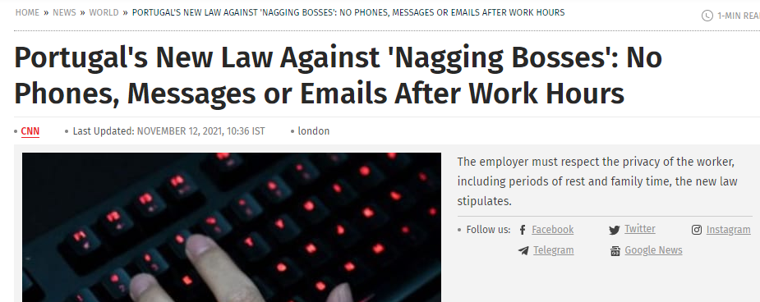
What is fake flex?

Slide 39
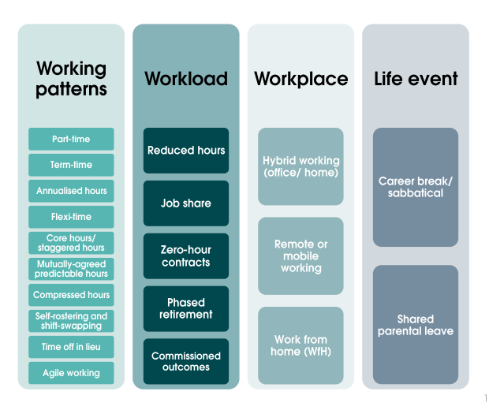
Flexonomics- the economic and fiscal value of flexible working
https://www.motherpukka.co.uk/wp-content/uploads/2021/12/2021-11-12-CONFIDENTIAL-Flexonomics-a-report-by-Pragmatix-Advisory-for-Sir-Robert-McAlpine-and-Mother-Pukka-2.pdf
Notes:
See CIPD inclusion at work report published 7 Dec 2022
https://www.cipd.co.uk/knowledge/fundamentals/relations/diversity/inclusion-work

Slide 40
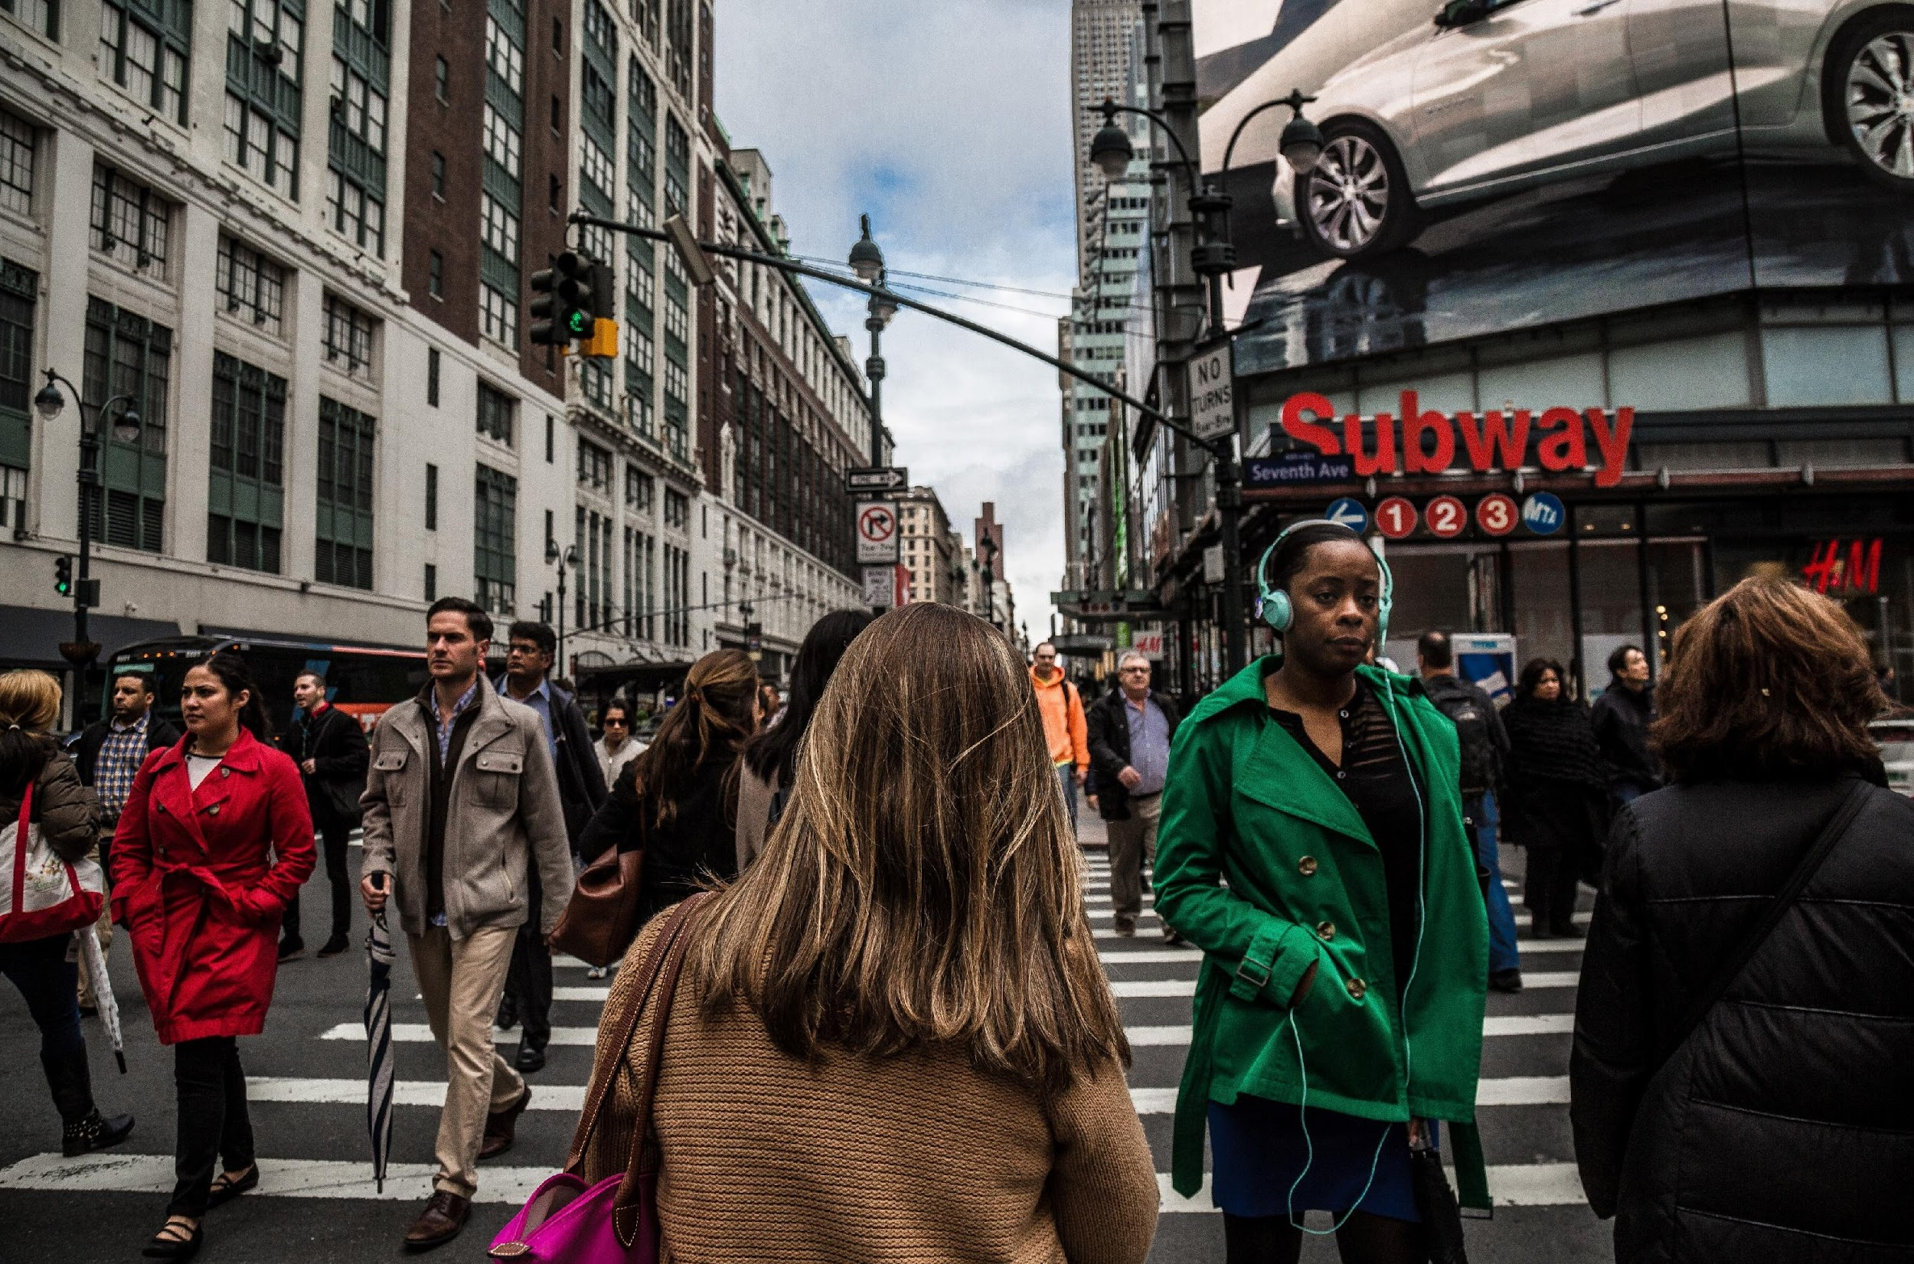
Action planning
Any ideas on actions you can make in your organisation or for your business?
Photo by Christopher Burns on Unsplash
Notes:
Professor D. Megginson, Sheffield Hallam Uni 2010

Slide 41
Mentimeter
What challenges do you see for you/ your organisation?
What challenges is your organisation facing at the moment in terms of inclusion?

Slide 42
Evaluation form
Please complete this short evaluation form found in chat
Your feedback is so valuable to us!
Notes:
Add link in chat – allow 5 minutes

Slide 43
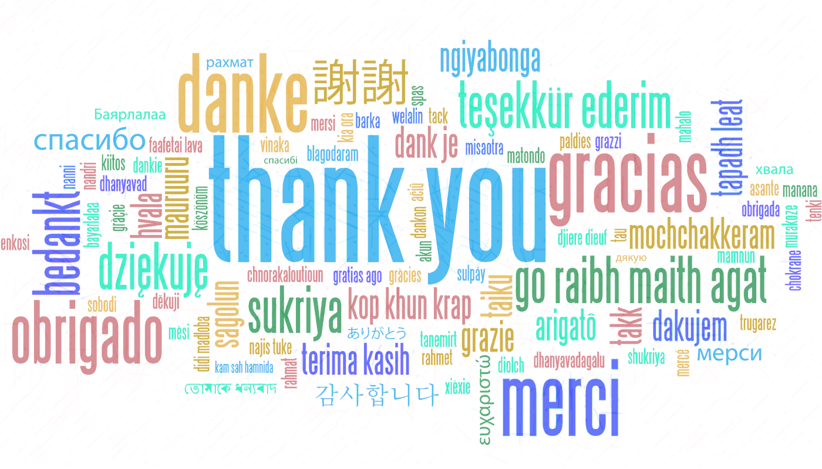
Any Questions? It’s been great to work with you all! Thank you!

Slide 44
References and sources
https://www.mckinsey.com/business-functions/organization/our-insights/gender-diversity-a-corporate-performance-driver
https://assets.publishing.service.gov.uk/government/uploads/system/uploads/attachment_data/file/594336/race-in-workplace-mcgregor-smith-review.pdf
https://www.gov.uk/government/publications/the-report-of-the-commission-on-race-and-ethnic-disparities/summary-of-recommendations
https://www.gov.uk/government/publications/unconscious-bias-and-diversity-training-what-the-evidence-says
https://hbr.org/2021/02/are-your-diversity-efforts-othering-underrepresented-groups
https://hbr.org/2021/04/research-adding-women-to-the-c-suite-changes-how-companies-think?utm_campaign=hbr&utm_medium=social&utm_source=linkedin
https://wgha.org.au/how-to-avoid-gender-bias-in-performance-reviews/
https://www.cipd.co.uk/knowledge/fundamentals/relations/diversity/inclusion-work

Slide 45
Additional information and useful websites
https://www.peoplemanagement.co.uk/news/articles/three-quarters-men-feel-stigmatised-taking-extended-paternity-leave
Document with timelines of legislation and women’s rights and gender equality pertaining to reproductive rights and sexual health, violence against women, home and family, education, work, women in senior roles, political representation, :
https://www.fawcettsociety.org.uk/Handlers/Download.ashx?IDMF=45a5a7f5-ffbd-4078-b0b7-4bfcccab159d
https://www.vox.com/2015/2/16/8031073/what-are-microaggressions
http://genderedinnovations.stanford.edu/policy/timeline.html
https://socialprotection-humanrights.org/key-issues/disadvantaged-and-vulnerable-groups/lgbtqi/
Notes:
https://www.thecareerpsychologist.com/wp-content/uploads/Daily-working-from-home-TCP-checklist-v2.pdf
See website above also for Covey’s circle of influence.

Slide 46
Thank you!
Name:
"The European Commission support for the production of this publication does not constitute an endorsement of the contents which reflects the views only of the authors, and the Commission cannot be held responsible for any use which may be made of the information contained therein."

